Slide 1



SmartSpend
An AI-Assisted Mobile Financial Tracking and Advisory Application for Personal Financial Management
Directo, Brix A.
Rubis, Cyrille John M.
Madayag, Djaunathan Albert S.
Adviser: Ellen F. Mangaoang, DIT
College of Computer Studies and Engineering, LORMA Colleges
November 2026

Slide 2

Opening Prayer

Slide 3

Money is managed without a system
2%
< 50%
10%
of Filipino adults answered all six basic financial literacy questions correctly
reported keeping any household or personal budget
of our 30 respondents use a mobile app to track expenses
BSP Financial Inclusion Survey, 2021
BSP Financial Inclusion Survey, 2021
SmartSpend needs assessment
A mixed picture (BSP CFIS 2025): basic literacy rose from 69% to 74%, but formal account ownership fell from 56% to 50%.
SmartSpend | LORMA Colleges, CCSE
‹#›

Slide 4



The gap exists at three levels
International
National (PH)
Demographic
PROBLEM
PROBLEM
PROBLEM
Manual entry dominates; AI categorization degrades for non-English transactions.
Local apps lack LLM chat, spending behavior analysis, and health scoring.
Parents abandon apps due to manual effort; warnings are ignored without consequences.
SMARTSPEND
SMARTSPEND
SMARTSPEND
LLM-based parsing for Filipino-English input
Conversational AI, Financial Health Score, multi-period summaries
Automated input and a score decay consequence system
SmartSpend | LORMA Colleges, CCSE
‹#›

Slide 5
What existing apps leave out
Feature | Tarsi | YNAB | Monarch | Copilot | BudgetPH | Alkansya AI | SmartSpend
Offline mode | ✓ | – | – | – | ✓ | – | ✓
LLM chat assistant | – | – | – | – | Insights | Basic | ✓
Financial Health Score | – | – | – | – | Simpler | – | ✓
OCR receipt scanning | ✓ | – | – | – | – | – | ✓
Voice input (en-PH) | – | – | – | – | – | – | ✓
Filipino-English AI | – | – | – | – | – | ✓ | ✓
Batch screenshot import | – | – | – | – | – | – | ✓
Bank synchronization | – | ✓ | ✓ | ✓ | CSV | – | –
Hands-on comparison of the apps in Table 1.2. Other PH apps (Agila, PISO Budget Tracker, Lista, Kibo, BunnyWise, GCash Pera Coach) are acknowledged; SmartSpend is an evaluated integrated prototype, not a claim to be first or only.
SmartSpend | LORMA Colleges, CCSE
‹#›

Slide 6
Three objectives guided the study
1
Assess
Financial management practices, budgeting challenges, and expense tracking behaviors of parents (35–55) and young professionals (21–35) in San Fernando City, La Union.
2
Design and develop
The SmartSpend app: multi-modal input, cloud sync, and an LLM API selected through comparative technical evaluation.
3
Evaluate
Usability and performance using the System Usability Scale (SUS) and user feedback.
SmartSpend | LORMA Colleges, CCSE
‹#›

Slide 7
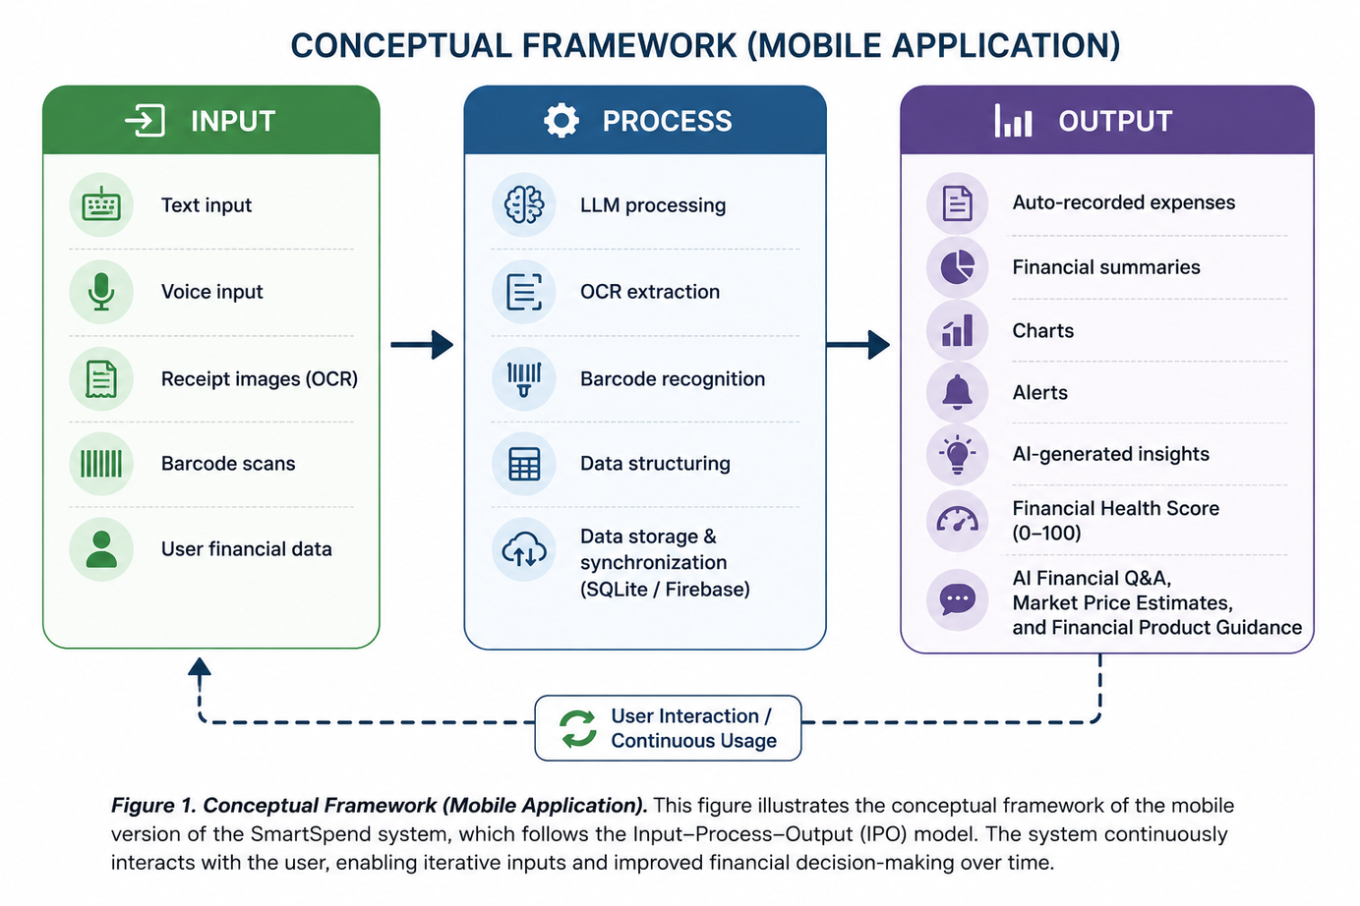
The Input-Process-Output framework
Input
Text, voice, receipt images, barcodes, user financial data
Process
LLM parsing, OCR, barcode recognition, SQLite storage, Firebase sync
Output
Auto-recorded expenses, charts, alerts, insights, Financial Health Score, AI Q&A
SmartSpend | LORMA Colleges, CCSE
‹#›

Slide 8
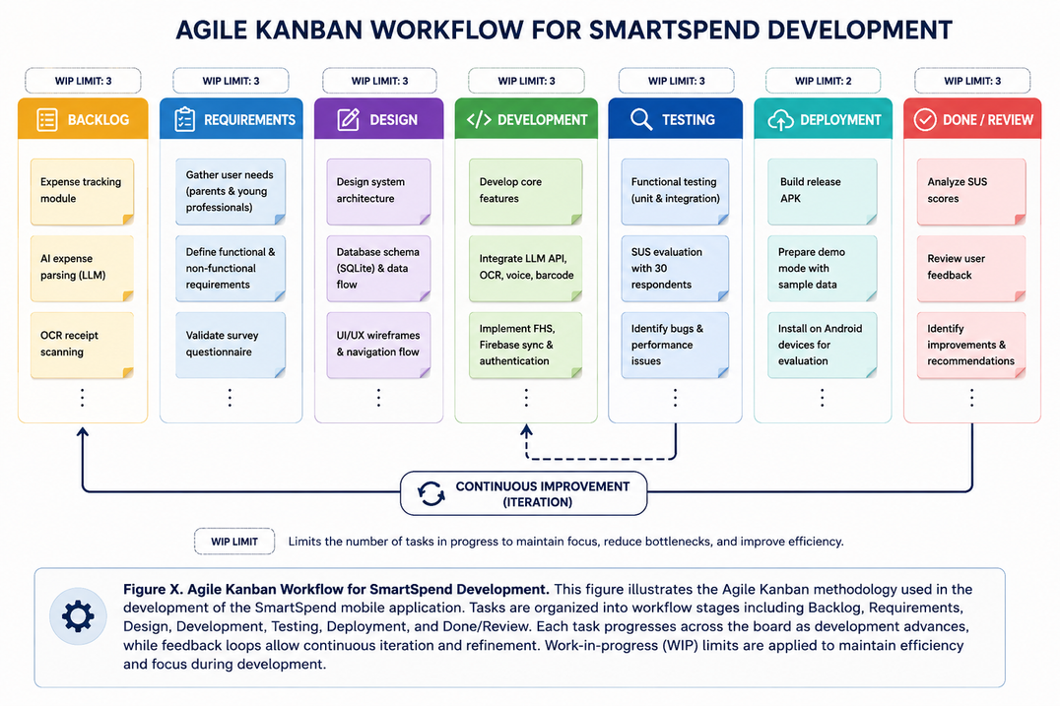
Mixed methods, built with Agile Kanban
30
respondents, purposive sampling: 13 parents, 14 young professionals, 3 both
2
Separate SUS sample: 30 valid of 36 (10 parents, 20 young professionals)
10
item SUS questionnaire; self-directed use for 10+ minutes (screening confirmed)
SmartSpend | LORMA Colleges, CCSE
‹#›

Slide 9
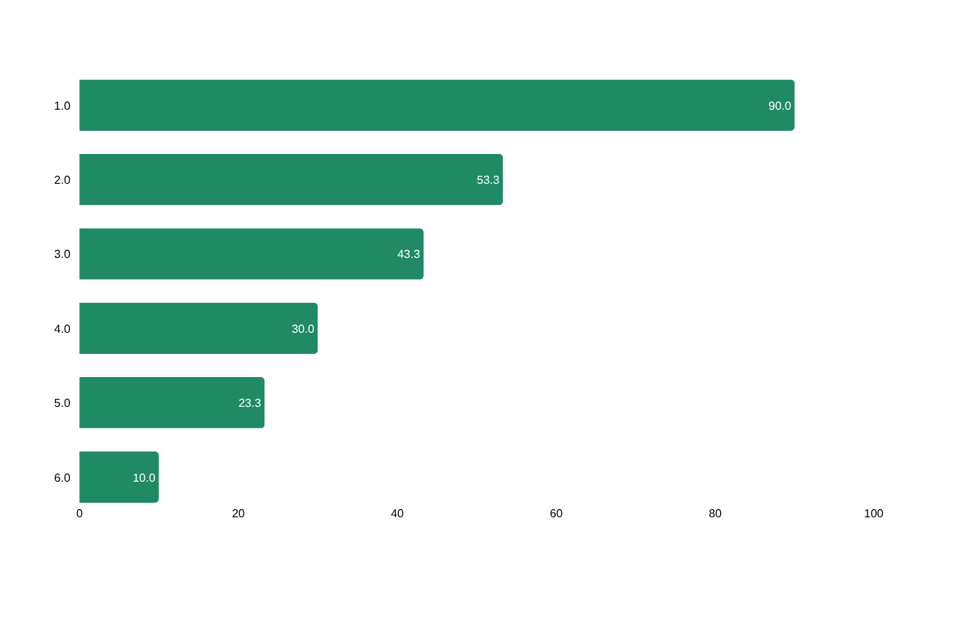
Objective 1: the need is real
96.7%
How respondents track expenses today (% of 30, multiple answers)
intend to use an AI-powered financial app
93.3%
already use GCash (28 of 30)
SmartSpend | LORMA Colleges, CCSE
‹#›

Slide 10
SmartSpend v3.1.0 at a glance
34
7
40+
26
autonomous AI actions
input modalities
screenshot platforms
SQLite tables
45
36
9
57
screens
achievement badges
AI providers (8 cloud + local)
currencies
Flutter (Android) • SQLite offline-first • Firebase sync and auth • APK ≈ 47.5 MB
SmartSpend | LORMA Colleges, CCSE
‹#›

Slide 11
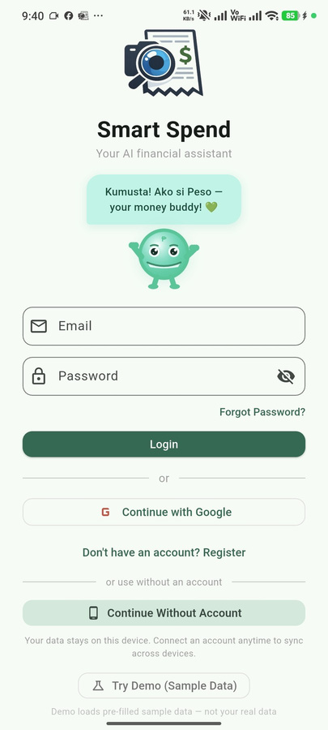




The app in action
Login and Demo Mode
Home and Health Score
Taglish chat with Peso
Receipt scanning (OCR)
Batch screenshot import
SmartSpend | LORMA Colleges, CCSE
‹#›

Slide 12
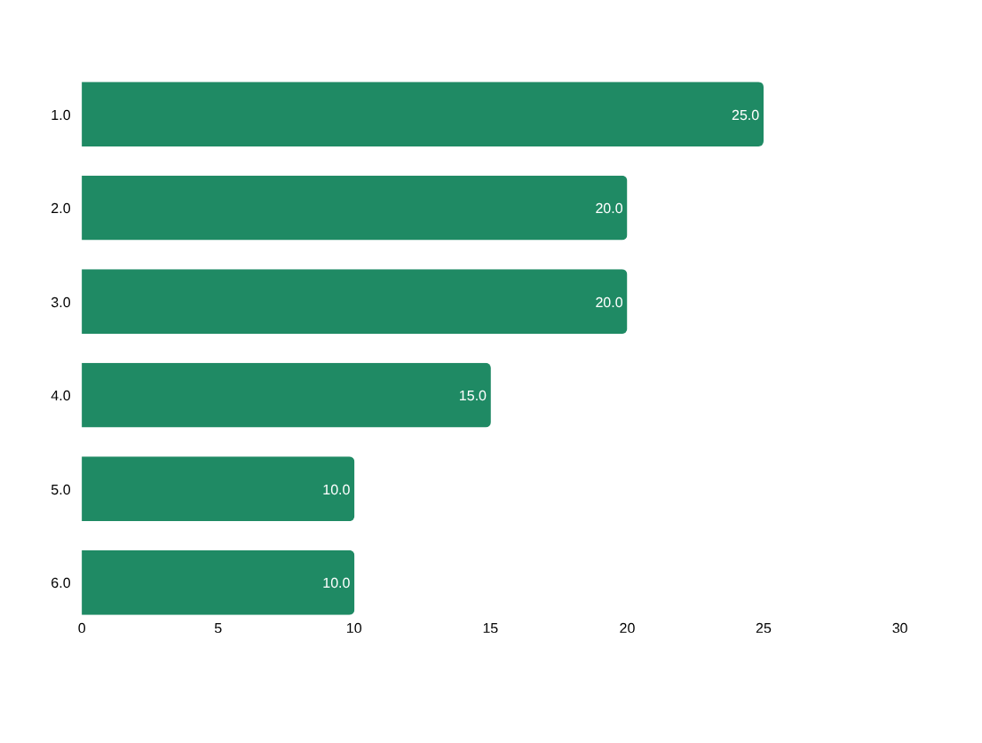
Choosing the AI engine
Evaluation: 6 weighted criteria, 20 candidate models
PRIMARY MODEL
Gemini 3.5 Flash-Lite
1M-token context, native function calling for 34 actions, strong Taglish in trials, high free-tier quota
7 fallback providers across Google, Groq, and Cerebras keep the assistant running if one is down or rate-limited.
Full-context injection, not RAG: a user's data is only ~1,000–5,000 tokens.
SmartSpend | LORMA Colleges, CCSE
‹#›

Slide 13
Financial Health Score: 0 to 100
Full Mode (income tracking on)
25
pts
25
pts
25
pts
25
pts
Savings Rate
Overspend Control
Budget Adherence
Logging Consistency
Lightweight Mode (no income tracking)
25
pts
25
pts
25
pts
25
pts
Spending Restraint
Logging Consistency
Category Balance
Habit Streak
Warning Decay up to −15 Gap Adjustment +2 no-spend / −3 unlogged day Clamped 0–100
SmartSpend | LORMA Colleges, CCSE
‹#›

Slide 14
Privacy by design: three AI tiers
1
Cloud AI (default)
2
Private Local Mode
3
On-device AI
On-device redaction of mobile numbers, reference numbers, and account patterns. 150 AI requests per user per day. Disclosure shown before the first AI message.
Requests go only to a model on the user's own PC (Ollama, LM Studio, Jan). Local-only switch blocks cloud fallback.
A model running on the phone itself, with no network. Feasible on 2026 flagships, not yet on 4 GB mid-range phones.
Implemented
Implemented
Planned
Designed with the Data Privacy Act of 2012 in mind. A risk-reduction measure, not a certification of legal compliance.
SmartSpend | LORMA Colleges, CCSE
‹#›

Slide 15
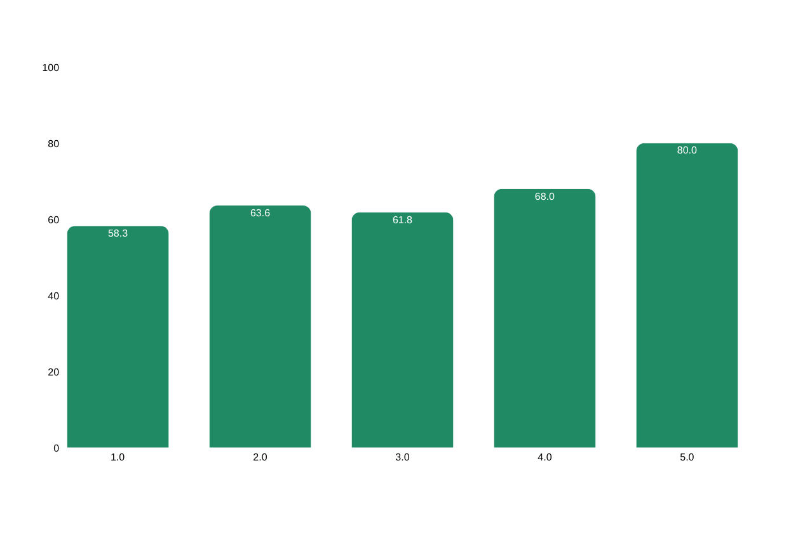
Objective 3: usability scored 61.83 (OK)
61.83
Mean SUS score (N = 30 valid of 36 responses)
Grade D, adjective "OK"
SD 17.58, median 55.0
Range 35.0–92.5
Q1 intent to use often: 4.35 / 5
Q9 felt confident: 4.19 / 5
Concerns: consistency (Q6), complexity (Q2, Q4)
SmartSpend | LORMA Colleges, CCSE
‹#›

Slide 16





Limitations we acknowledge
Usability below target
Android and internet
Prototype-grade security
SUS 61.83 is under the 68 avg. benchmark (Sauro & Lewis 2016) and the 80 target.
Android only; all AI features need a connection.
API key via Remote Config; local database not encrypted.
Parsing accuracy
Behavior impact unmeasured
Small, local sample
91.2% precision / 88.5% recall from developer testing.
Peso and badges were added after the evaluation was designed.
30 purposive respondents from one locale; not generalizable.
SmartSpend | LORMA Colleges, CCSE
‹#›

Slide 17
Conclusions
1
Needs assessment
96.7% intent to use an AI finance app; 93.3% use GCash.
Achieved
2
Design and development
v3.1.0 working Android app: 34 AI actions, Gemini 3.5 Flash-Lite with failover, Financial Health Score.
Achieved
3
Usability evaluation
SUS 61.83: below the 68 average and the 80 target; UI/UX areas identified
Partially achieved
SmartSpend | LORMA Colleges, CCSE
‹#›

Slide 18
Recommendations
Payday-cycle budgeting
Resets aligned to the 15th and 30th salary cycle
SQLite encryption
SQLCipher for the local database
1
5
Backend API proxy
Server-side keys and per-user limits; remove device-side key exposure
Household and remittance
Shared wallets and OFW remittance as a distinct income category
2
6
Google Play release
After backend proxy and privacy policy are in place
Longitudinal evaluation
3–6 months, larger sample, measure behavior change
3
7
On-device AI tier
Opt-in ~2.6 GB model for fully offline AI
4
SmartSpend | LORMA Colleges, CCSE
‹#›

Slide 19

Salamat po!
Questions and discussion
Directo, Rubis, Madayag
Adviser: Ellen F. Mangaoang, DIT
github.com/Zushikina-kun/smartspend-app

